Slide 1

ABE 715
Computer Programming
Lecture 12: Computer Vision in Agriculture
Image Processing with OpenCV and Python
Dr. Kadeghe G. Fue
Department of Agricultural Engineering
1

Slide 2
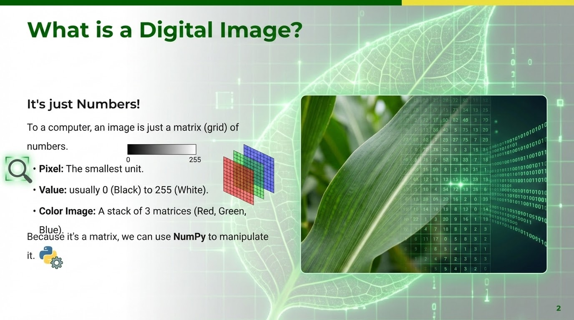

Slide 3
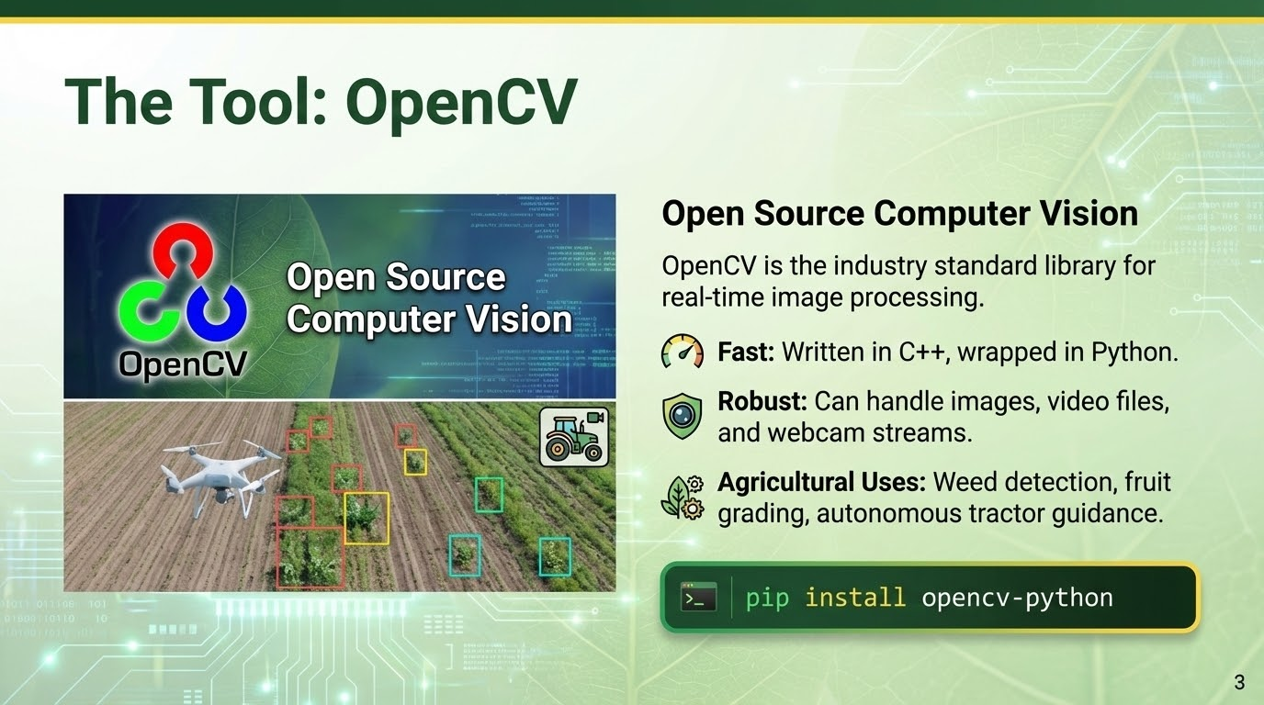

Slide 4
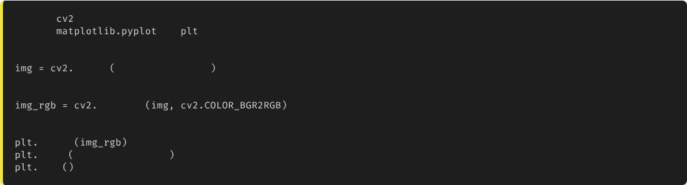
Reading and Showing Images
import
import
as
# 1. Read Image (Loads as BGR)
imread
"maize_leaf.jpg"
# 2. Convert BGR to RGB (for Matplotlib display)
cvtColor
# 3. Display
imshow
title
"Original Image"
show
Note: OpenCV reads colors as Blue-Green-Red (BGR) by default, unlike the standard RGB.
4

Slide 5
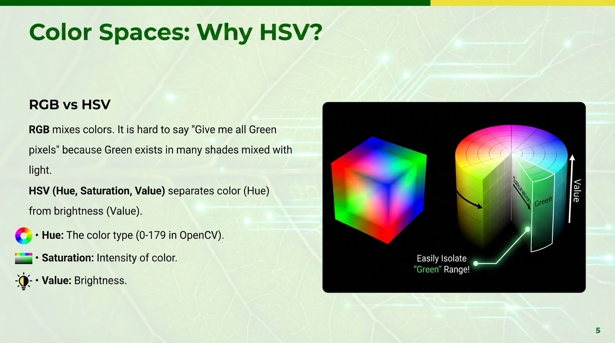

Slide 6
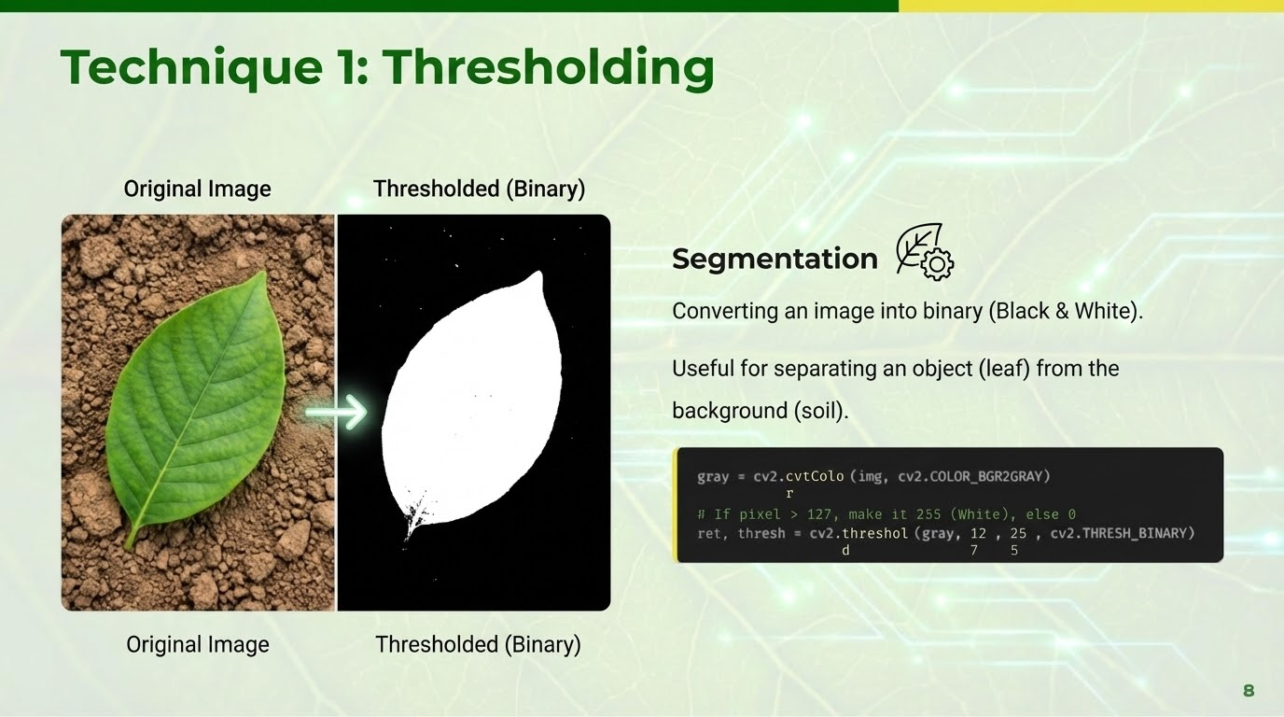

Slide 7
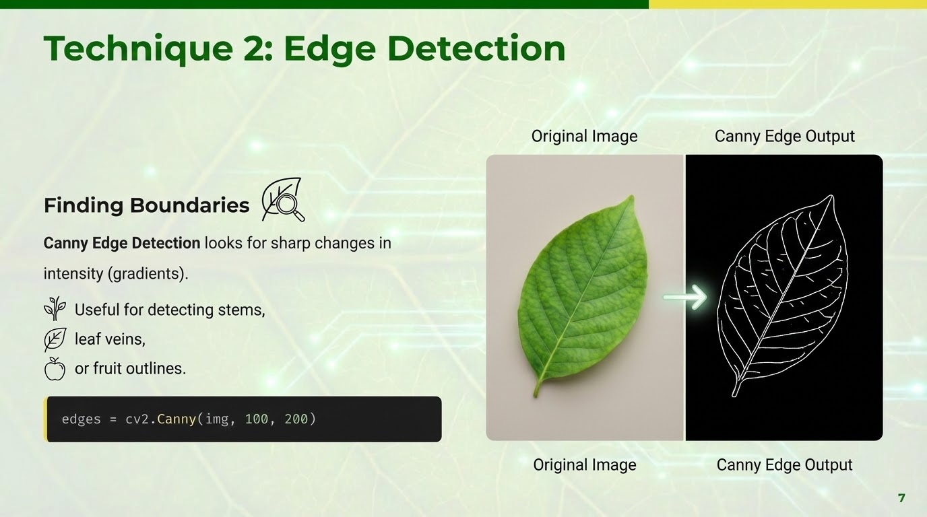

Slide 8
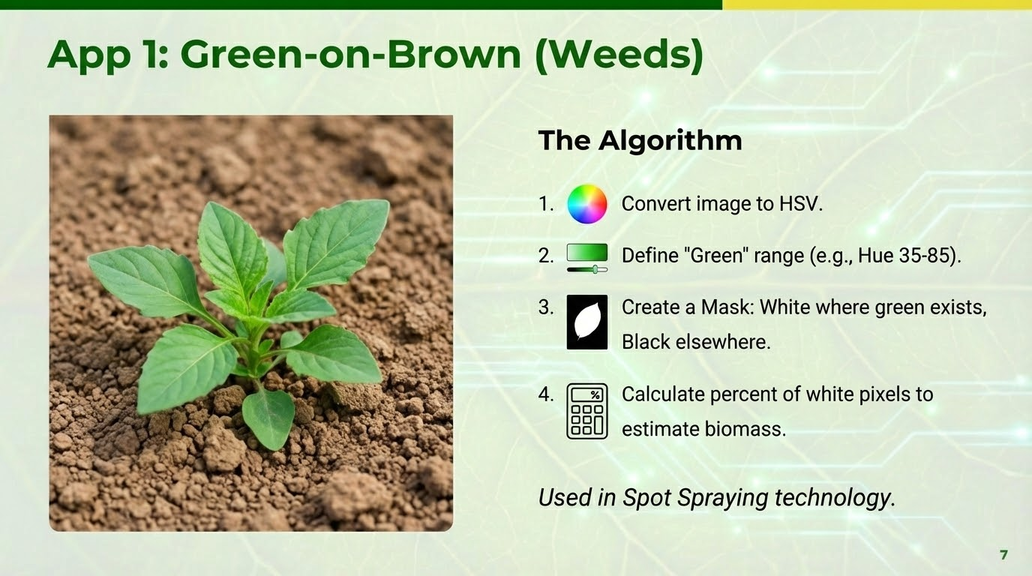

Slide 9
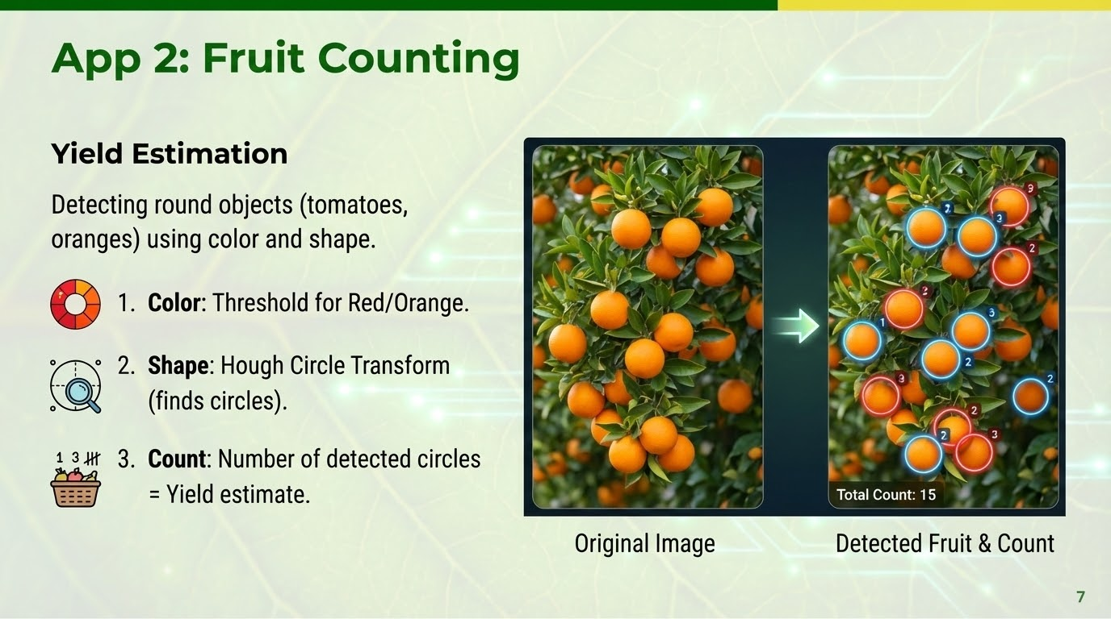

Slide 10
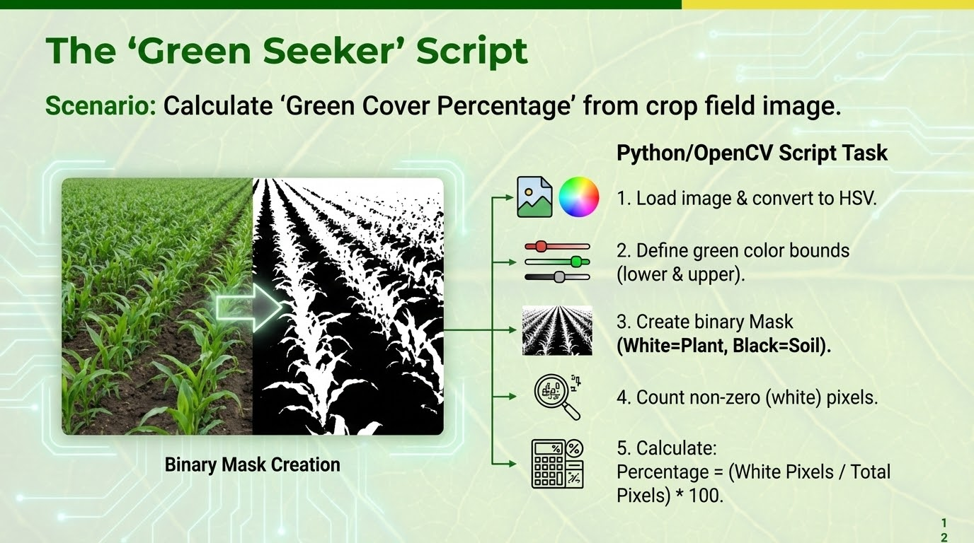

Slide 11







The General CV Workflow
1. Acquisition
2. Pre-processing
3. Feature Extraction
Load image from file or webcam.
Resize, Blur (remove noise), Convert Color Space.
Thresholding, Edge Detection, Contour finding.
4. Analysis
Count objects, Measure area, Classify.
11

Slide 12

Lecture 12: Take-Home Assignment
The "Green Seeker" Script
Scenario: You have an image of a crop field (field.jpg). You need to calculate the "Green Cover Percentage" to estimate growth stage.
Task: Write a Python script using OpenCV to:
1.
Load the image and convert it to HSV.
2.
Define a lower and upper bound for the color Green.
3.
Create a binary Mask (White = Plant, Black = Soil).
4.
Count the number of non-zero (white) pixels.
5.
Calculate: Percentage = (White Pixels / Total Pixels) * 100.
12

Slide 13
Questions?
Next Class: Machine Learning Basics for Agriculture
Dr. Kadeghe G. Fue
Department of Agricultural Engineering
13

